Slide 1


Session 3
Ivo Rojas.

Slide 2

Content
Services
Observables

Slide 3
SERVICES

Slide 4
SERVICES
Dependency Injection.
Service Creation.
Use a Service.

Slide 5
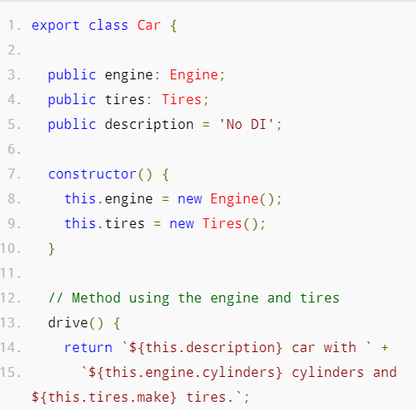
Dependency Injection.

Slide 6
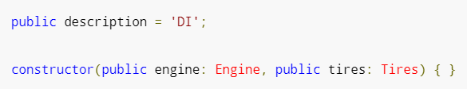

Dependency Injection.

Slide 7
What is a SERVICE?
Component A
Component B
Component C
Service

Slide 8
What is a SERVICE?
Switch
LightBulb
Service

Slide 9
Service Creation.
Angular-cli:
ng generate service [serviceName]

Slide 10
Use a Service
Import
Add to Constructor (Dependency injection)
Call function or attribute of service.

Slide 11

Break

Slide 12
OBSERVABLES

Slide 13
What is a Observable?
Observable A
Subscribe
Observer 1
Subscribe
Observable B
Observer 2
Subscribe
Observer 3
Time Line.

Slide 14
ObservableS
Observables | Promise
Observables handle multiple values over time | Promises are only called once and will return a single value
Observables are cancellable | Promises are not cancellable

Slide 15
observableS
Observables is an ES7 feature which means you need to make use of an external library to use it today. RxJS is a good one.

Slide 16
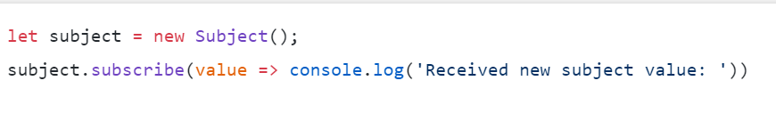

RxJs Subject and how to use it
Subject A
Subscribe
Subject A
Subscribe
Subject B
Subject A
Subscribe
Subject B

Slide 17

BehaviorSubject and how to use it
BehaviorSubject
A
BehaviorSubject
A
Subscribe

Slide 18
Links
http://blog.angular-university.io/how-to-build-angular2-apps-using-rxjs-observable-data-services-pitfalls-to-avoid/
Twitter: @ircube github: ircube

Slide 19
Questions?

